Slide 1
IE 340/440
PROCESS IMPROVEMENT
THROUGH PLANNED EXPERIMENTATION
IE 406
Simulation
Numerical Descriptive Measures
Dr. Xueping Li
University of Tennessee
© 2003 Prentice-Hall, Inc.
Chap 3-<number>

Slide 2
Chapter Topics
Measures of Central Tendency
  Mean, Median, Mode, Geometric Mean
Quartile
Measure of Variation
  Range, Interquartile Range, Variance and Standard Deviation, Coefficient of Variation
Shape
  Symmetric, Skewed, Using Box-and-Whisker Plots
Chap 3-<number>
© 2003 Prentice-Hall, Inc.

Slide 3
Chapter Topics
(continued)
The Empirical Rule and the Bienayme-Chebyshev Rule
Coefficient of Correlation
Pitfalls in Numerical Descriptive Measures and Ethical Issues
Chap 3-<number>
© 2003 Prentice-Hall, Inc.

Slide 4
Summary Measures
Summary Measures
Central Tendency
Quartile
Variation
Mean
Mode
Median
Range
Coefficient of Variation
Variance
Standard Deviation
Geometric Mean
Chap 3-<number>
© 2003 Prentice-Hall, Inc.

Slide 5
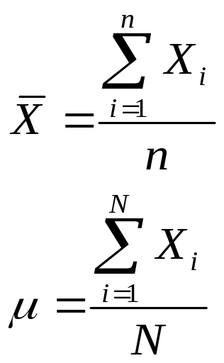

Measures of Central Tendency
Central Tendency
Mean
Median
Mode
Geometric Mean
Chap 3-<number>
© 2003 Prentice-Hall, Inc.

Slide 6
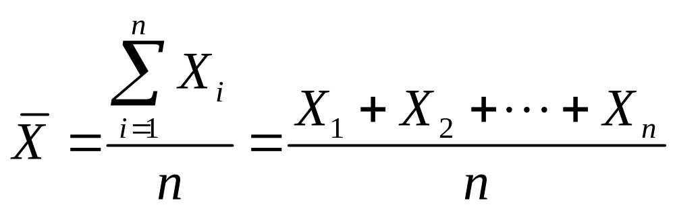
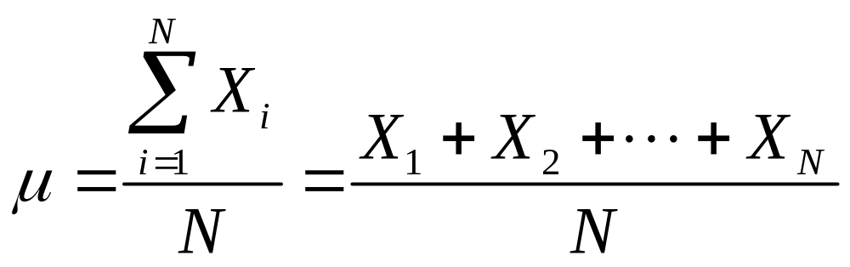
Mean (Arithmetic Mean)
Mean (Arithmetic Mean) of Data Values
  Sample mean
  Population mean
Sample Size
Population Size
Chap 3-<number>
© 2003 Prentice-Hall, Inc.

Slide 7
Mean (Arithmetic Mean)
(continued)
The Most Common Measure of Central Tendency
Affected by Extreme Values (Outliers)
0 1 2 3 4 5 6 7 8 9 10
0 1 2 3 4 5 6 7 8 9 10 12 14
Mean = 5
Mean = 6
Chap 3-<number>
© 2003 Prentice-Hall, Inc.

Slide 8
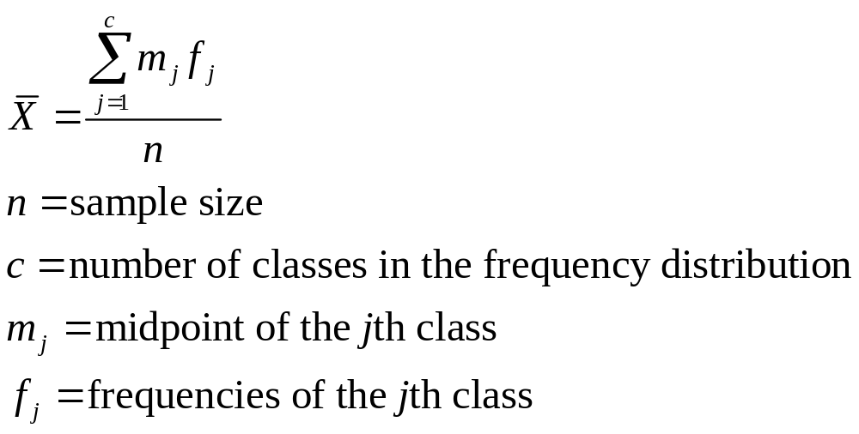
Mean (Arithmetic Mean)
(continued)
Approximating the Arithmetic Mean
  Used when raw data are not available
Chap 3-<number>
© 2003 Prentice-Hall, Inc.

Slide 9
Median
Robust Measure of Central Tendency
Not Affected by Extreme Values
In an Ordered Array, the Median is the ‘Middle’ Number
  If n or N is odd, the median is the middle number
  If n or N is even, the median is the average of the 2 middle numbers
0 1 2 3 4 5 6 7 8 9 10
0 1 2 3 4 5 6 7 8 9 10 12 14
Median = 5
Median = 5
Chap 3-<number>
© 2003 Prentice-Hall, Inc.

Slide 10
Mode
A Measure of Central Tendency
Value that Occurs Most Often
Not Affected by Extreme Values
There May Not Be a Mode
There May Be Several Modes
Used for Either Numerical or Categorical Data
0 1 2 3 4 5 6
0 1 2 3 4 5 6 7 8 9 10 11 12 13 14
No Mode
Mode = 9
Chap 3-<number>
© 2003 Prentice-Hall, Inc.

Slide 11
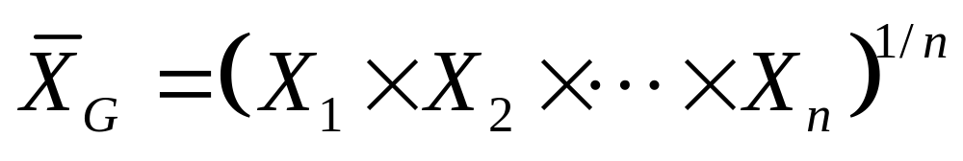
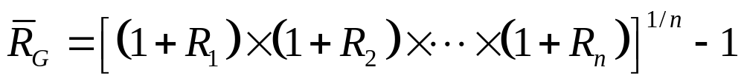
Geometric Mean
Useful in the Measure of Rate of Change of a Variable Over Time
Geometric Mean Rate of Return
  Measures the status of an investment over time
Chap 3-<number>
© 2003 Prentice-Hall, Inc.

Slide 12
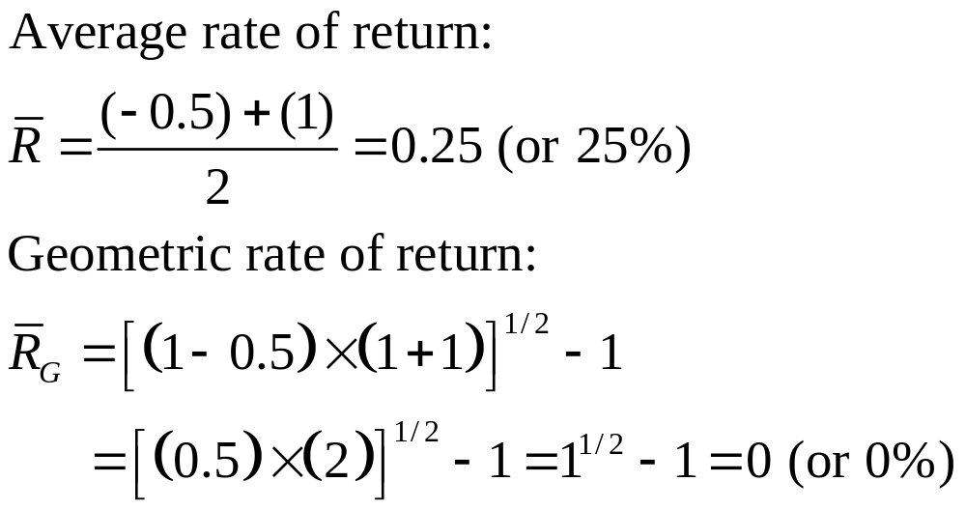
Example
An investment of $100,000 declined to $50,000 at the end of year one and rebounded back to $100,000 at end of year two:
Chap 3-<number>
© 2003 Prentice-Hall, Inc.

Slide 13
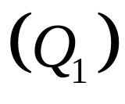
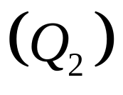
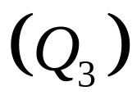
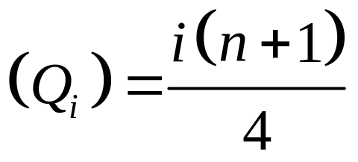
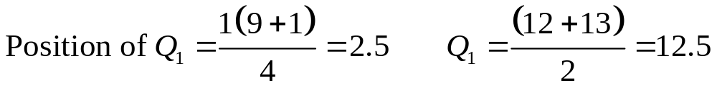
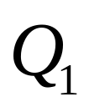
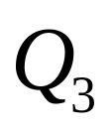
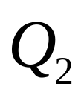
Quartiles
Split Ordered Data into 4 Quarters
Position of i-th Quartile
and are Measures of Noncentral Location
= Median, a Measure of Central Tendency
25%
25%
25%
25%
Data in Ordered Array: 11 12 13 16 16 17 18 21 22
Chap 3-<number>
© 2003 Prentice-Hall, Inc.

Slide 14
Measures of Variation
Variation
Variance
Standard Deviation
Coefficient of Variation
Range
Population
Variance
Population
Standard
Deviation
Sample
Variance
Sample
Standard
Deviation
Interquartile Range
Chap 3-<number>
© 2003 Prentice-Hall, Inc.

Slide 15
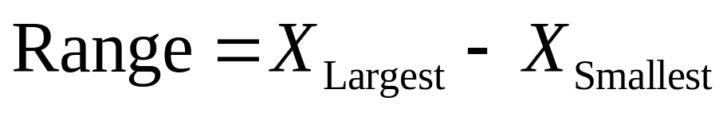
Range
Measure of Variation
Difference between the Largest and the Smallest Observations:
Ignores How Data are Distributed
Range = 12 - 7 = 5
Range = 12 - 7 = 5
7 8 9 10 11 12
7 8 9 10 11 12
Chap 3-<number>
© 2003 Prentice-Hall, Inc.

Slide 16
Interquartile Range
Measure of Variation
Also Known as Midspread
  Spread in the middle 50%
Difference between the First and Third Quartiles
Not Affected by Extreme Values
Data in Ordered Array: 11 12 13 16 16 17 17 18 21
Chap 3-<number>
© 2003 Prentice-Hall, Inc.

Slide 17
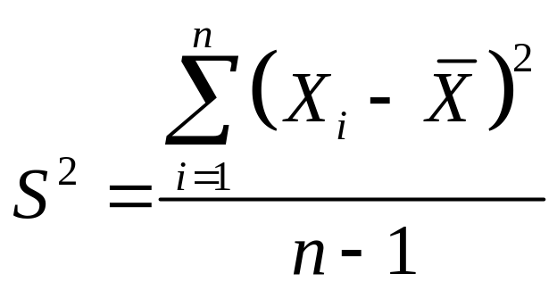
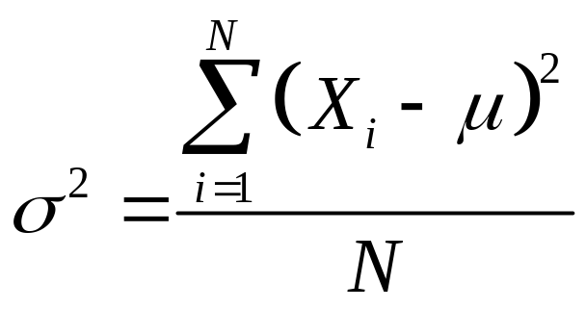
Variance
Important Measure of Variation
Shows Variation about the Mean
  Sample Variance:
  Population Variance:
Chap 3-<number>
© 2003 Prentice-Hall, Inc.

Slide 18
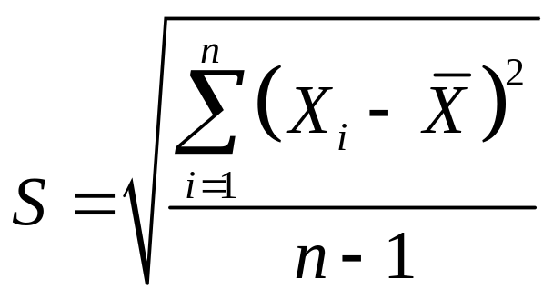
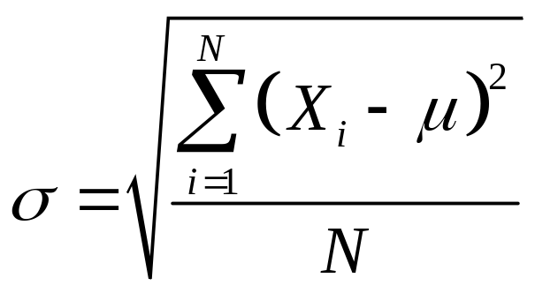
Standard Deviation
Most Important Measure of Variation
Shows Variation about the Mean
Has the Same Units as the Original Data
  Sample Standard Deviation:
  Population Standard Deviation:
Chap 3-<number>
© 2003 Prentice-Hall, Inc.

Slide 19
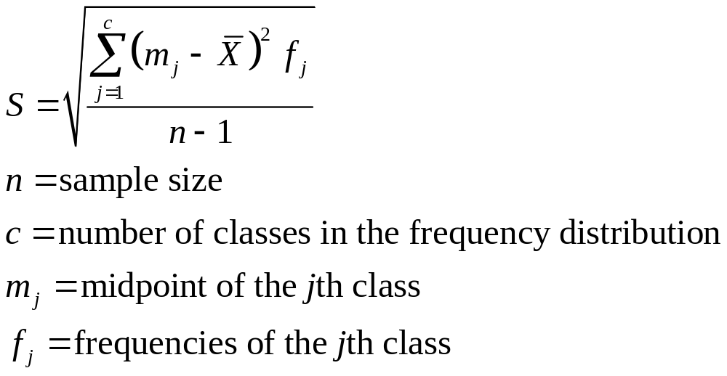
Standard Deviation
(continued)
Approximating the Standard Deviation
  Used when the raw data are not available and the only source of data is a frequency distribution
Chap 3-<number>
© 2003 Prentice-Hall, Inc.

Slide 20
Comparing Standard Deviations
Data A
Mean = 15.5
s = 3.338
11 12 13 14 15 16 17 18 19 20 21
Data B
Mean = 15.5
s = .9258
11 12 13 14 15 16 17 18 19 20 21
Data C
Mean = 15.5
s = 4.57
11 12 13 14 15 16 17 18 19 20 21
Chap 3-<number>
© 2003 Prentice-Hall, Inc.

Slide 21
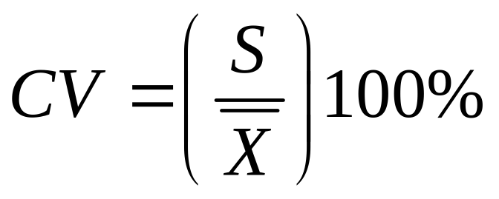
Coefficient of Variation
Measure of Relative Variation
Always in Percentage (%)
Shows Variation Relative to the Mean
Used to Compare Two or More Sets of Data Measured in Different Units
Sensitive to Outliers
Chap 3-<number>
© 2003 Prentice-Hall, Inc.

Slide 22
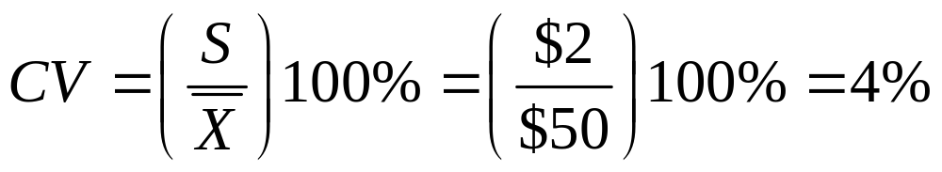
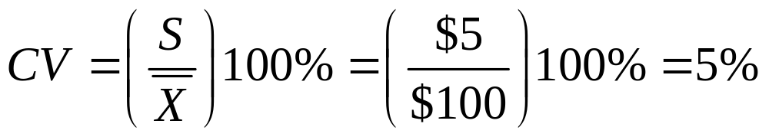
Comparing Coefficient of Variation
Stock A:
  Average price last year = $50
  Standard deviation = $2
Stock B:
  Average price last year = $100
  Standard deviation = $5
Coefficient of Variation:
  Stock A:
  Stock B:
Chap 3-<number>
© 2003 Prentice-Hall, Inc.

Slide 23
Shape of a Distribution
Describe How Data are Distributed
Measures of Shape
  Symmetric or skewed
Left-Skewed
Symmetric
Right-Skewed
Mean < Median < Mode
Mean = Median =Mode
Mode < Median < Mean
Chap 3-<number>
© 2003 Prentice-Hall, Inc.

Slide 24
Exploratory Data Analysis
Box-and-Whisker
  Graphical display of data using 5-number summary
Median( )
X
X
smallest
largest
4
6
8
10
12
Chap 3-<number>
© 2003 Prentice-Hall, Inc.

Slide 25


Distribution Shape &
Box-and-Whisker
Left-Skewed
Symmetric
Right-Skewed
Chap 3-<number>
© 2003 Prentice-Hall, Inc.

Slide 26
The Empirical Rule
For Most Data Sets, Roughly 68% of the Observations Fall Within 1 Standard Deviation Around the Mean
Roughly 95% of the Observations Fall Within 2 Standard Deviations Around the Mean
Roughly 99.7% of the Observations Fall Within 3 Standard Deviations Around the Mean
Chap 3-<number>
© 2003 Prentice-Hall, Inc.

Slide 27
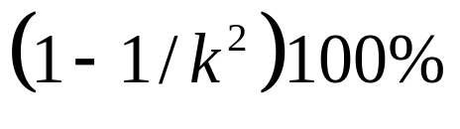
The Bienayme-Chebyshev Rule
The Percentage of Observations Contained Within Distances of k Standard Deviations Around the Mean Must Be at Least
  Applies regardless of the shape of the data set
  At least 75% of the observations must be contained within distances of 2 standard deviations around the mean
  At least 88.89% of the observations must be contained within distances of 3 standard deviations around the mean
  At least 93.75% of the observations must be contained within distances of 4 standard deviations around the mean
Chap 3-<number>
© 2003 Prentice-Hall, Inc.

Slide 28
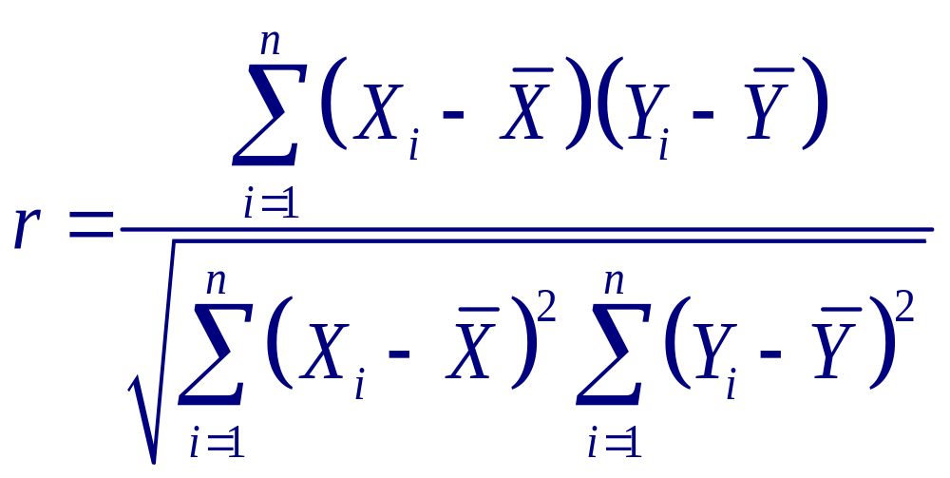
Coefficient of Correlation
Measures the Strength of the Linear Relationship between 2 Quantitative Variables
Chap 3-<number>
© 2003 Prentice-Hall, Inc.

Slide 29
Features of Correlation Coefficient
Unit Free
Ranges between –1 and 1
The Closer to –1, the Stronger the Negative Linear Relationship
The Closer to 1, the Stronger the Positive Linear Relationship
The Closer to 0, the Weaker Any Linear Relationship
Chap 3-<number>
© 2003 Prentice-Hall, Inc.

Slide 30
Scatter Plots of Data with Various Correlation Coefficients
Y
Y
Y
X
X
X
r = -1
r = -.6
r = 0
Y
Y
X
X
r = .6
r = 1
Chap 3-<number>
© 2003 Prentice-Hall, Inc.

Slide 31
Pitfalls in Numerical Descriptive Measures and Ethical Issues
Data Analysis is Objective
  Should report the summary measures that best meet the assumptions about the data set
Data Interpretation is Subjective
  Should be done in a fair, neutral and clear manner
Ethical Issues
  Should document both good and bad results
  Presentation should be fair, objective and neutral
  Should not use inappropriate summary measures to distort the facts
Chap 3-<number>
© 2003 Prentice-Hall, Inc.

Slide 32
Chapter Summary
Described Measures of Central Tendency
  Mean, Median, Mode, Geometric Mean
Discussed Quartiles
Described Measures of Variation
  Range, Interquartile Range, Variance and Standard Deviation, Coefficient of Variation
Illustrated Shape of Distribution
  Symmetric, Skewed, Using Box-and-Whisker Plots
Chap 3-<number>
© 2003 Prentice-Hall, Inc.

Slide 33
Chapter Summary
(continued)
Described the Empirical Rule and the Bienayme-Chebyshev Rule
Discussed Correlation Coefficient
Addressed Pitfalls in Numerical Descriptive Measures and Ethical Issues
Chap 3-<number>
© 2003 Prentice-Hall, Inc.

